Slide 1

MAJOR SHIFT IN HOW MUSIC AND OTHER ARTISTIC ORIGINALS ARE CLASSIFIED ACCORDING THE BUREAU OF ECONOMIC ANALYSIS

Slide 2
PROPOSED CALIROYAL MOGULS JOINT VENTURE
JOINT VENTURE FOR CONTENT CURATION AND DISTRIBUTION THROUGH ARKANSAS EARTH STATION USING WILD MOGULS MASTER CONTROL LICENSE AND PARTNERING WITH OTHER SIMILARLY ORIENTED ORGANIZATIONS SPECIALIZING IN DIGITAL MEDIA. MULTI MEDIA AND CONTENT CURATION AND MANAGEMENT
CALIROYAL HAS PROPREITARY BUSINESS SYSTEMS INFRASTRUCTURE AND PROTYPE DESIGN FOR GRAPHICAL USER INTERFACES FOR BOTH FRONT END SYSTEM FUNCTIONALITY AND BACKEND SYSTEM INTEGRATION THROUGH MICROSOFT AZURE VIRTUAL MACHINE AND WORDPRESSS AND PHP WEBSITE HOSTING PROTOCOLS

Slide 3
HAD PREVIOUSLY ESTABLISHED TENTATIVE ARRANGEMENTS WITH WILD MOGULS IN 2015 BUT DUE TO LACK OF CAPITAL, WAS UNABLE TO ESTABLISH CONTRACTUAL RELATIONSHIPS

Slide 4
RETAIL DIVISION RETAIL NOTES

Slide 5
KEY REFERENCE POINTS
VERISON ANNUAL REPORTS FROM 2014-2016
AT&T ANNUAL REPORTS FROM 2014-2016
MUSIC BUSINESS WORLDWIDE ARTICLES:
CALIROYAL MARKET NICHE:
NO EXPLICIT LYRICS ON PLATFORM
EXCLUSIVE DISTRIBUTION ARRANGEMENTS WITH RECORD LABELS AND PRODUCTION COMPANIES THROUGH JOINT VENTURES STRUCTURE AS CORPORATE ENTITY EQUITIES AND PROJECTS WITH A DURATION NOT TO EXCEED 5 YEARS
NO STREAMING OF CONTENT ON PLATFORM
STREAMING DEVALUES THE ARITIST’S SHARE OF REVENUES
DIGITAL DOWNLOADS AND CD DISTRIBUTION IS THE OBJECTIVE
PER UNIT SALES REVENUES ARE EXPECTED TO EXPONENTIALLY INCREASE ARTIS SHARE OF REVENUES

Slide 6
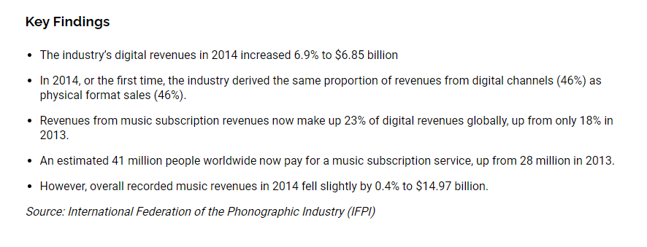
RIAA MUSIC REVENUE DATA
CALENDAR YEAR 2015
https://www.riaa.com/reports/digital-music-report-2015/

Slide 7
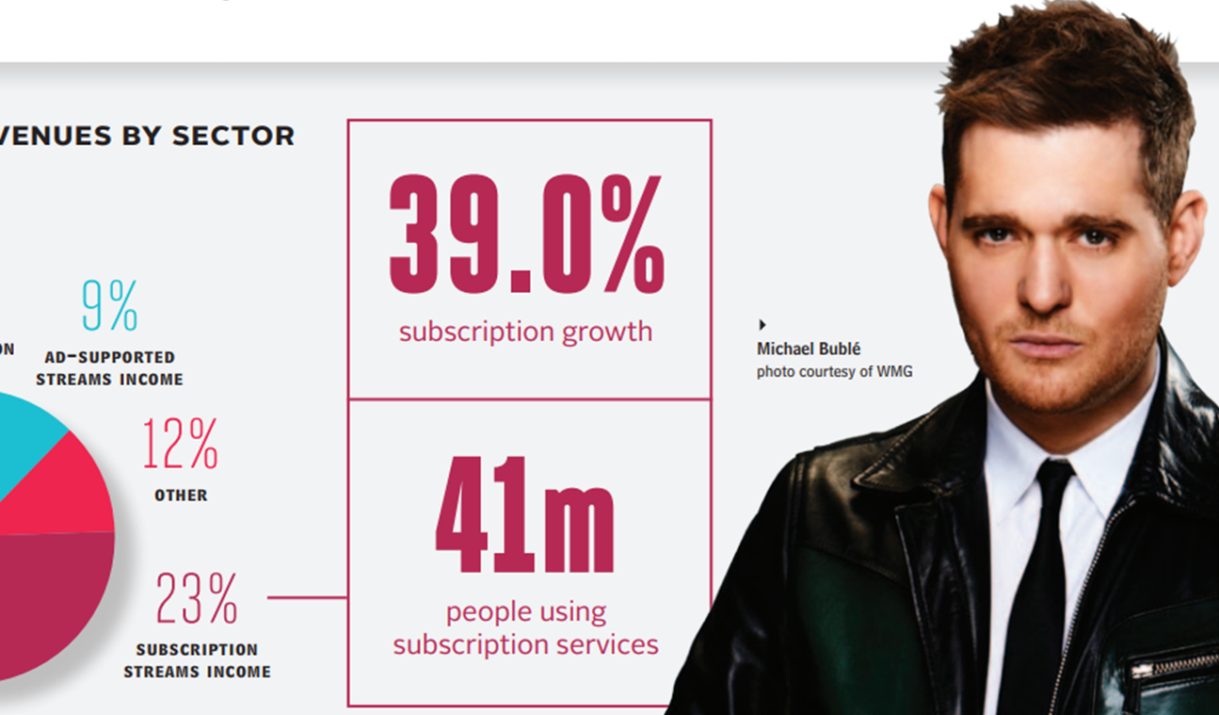
RIAA MUSIC REVENUE DATA
CALENDAR YEAR 2015
https://www.riaa.com/reports/digital-music-report-2015/

Slide 8
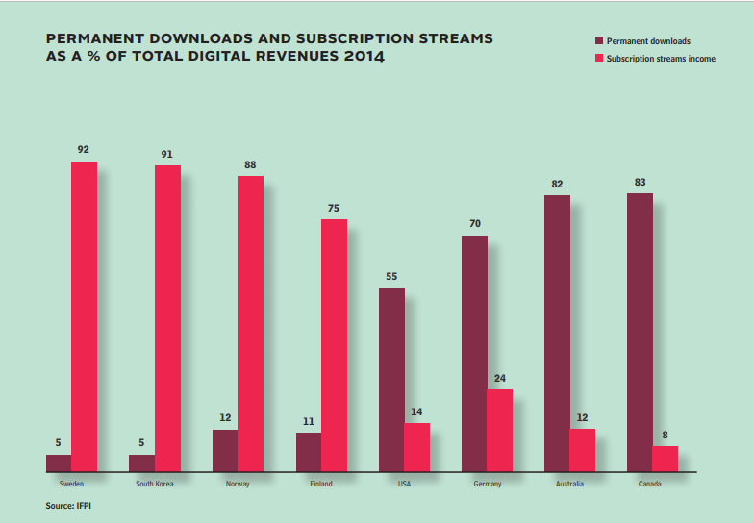
RIAA MUSIC REVENUE DATA
CALENDAR YEAR 2015
https://www.riaa.com/reports/digital-music-report-2015/

Slide 9
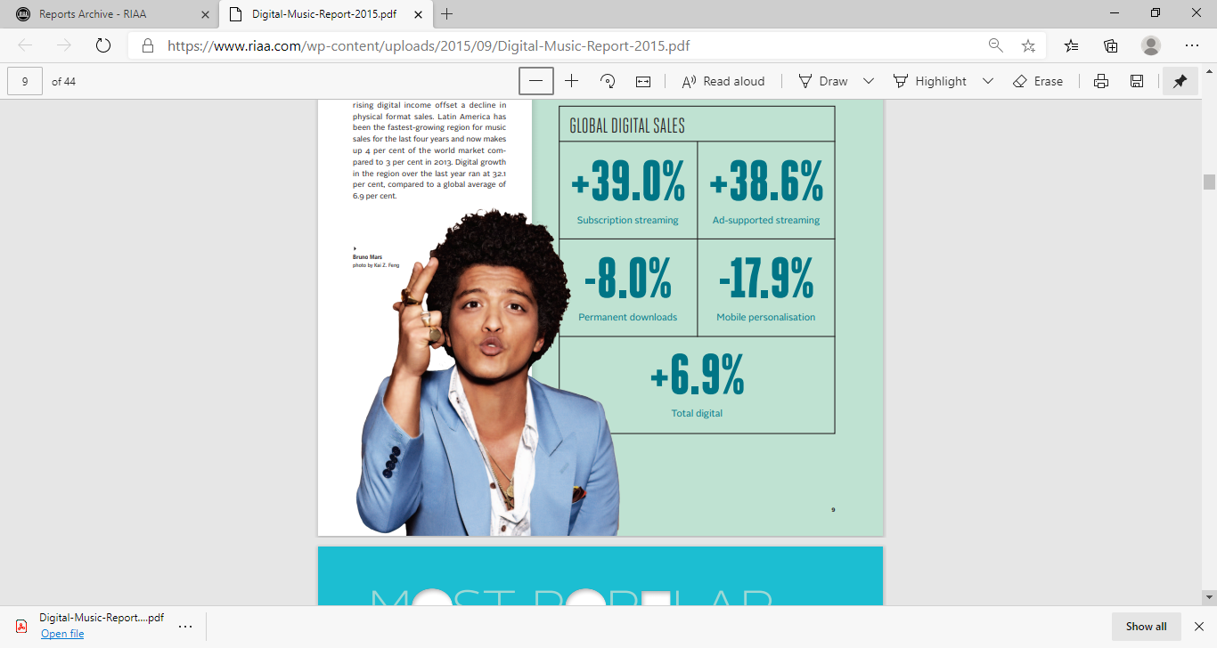
RIAA MUSIC REVENUE DATA
CALENDAR YEAR 2015
https://www.riaa.com/reports/digital-music-report-2015/

Slide 10
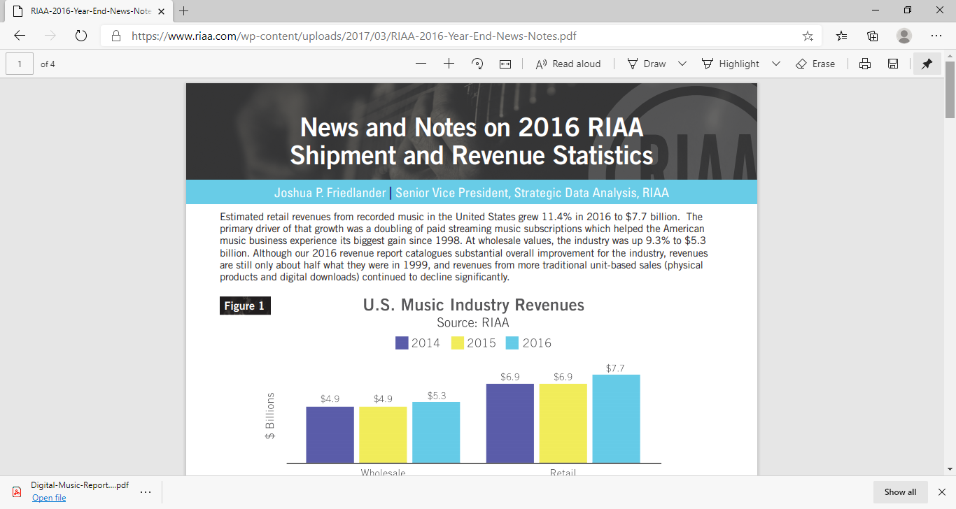
RIAA MUSIC REVENUE DATA
CALENDAR YEAR 2016
https://www.riaa.com/wp-content/uploads/2017/03/RIAA-2016-Year-End-News-Notes.pdf

Slide 11
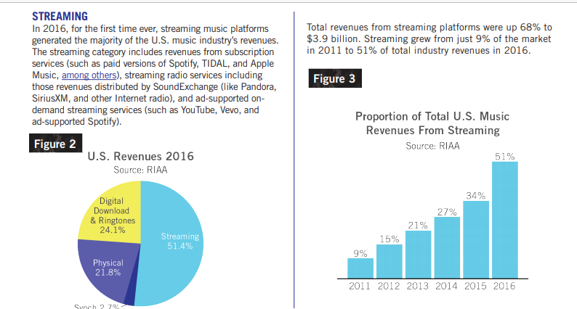
RIAA MUSIC REVENUE DATA
CALENDAR YEAR 2016
https://www.riaa.com/wp-content/uploads/2017/03/RIAA-2016-Year-End-News-Notes.pdf

Slide 12
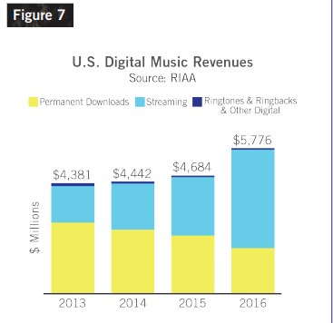
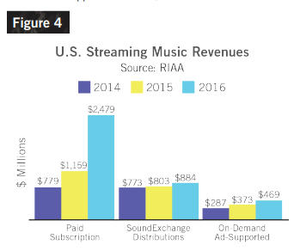
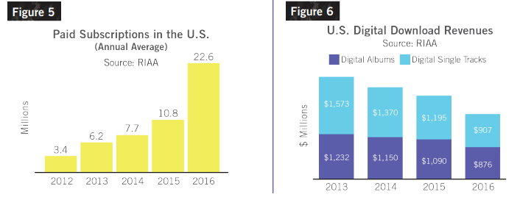
AS STREAMING REVENUES INCREASE, PAID SUBSCRIPTIONS INCREASE AND DIGITAL DOWNLOADS DECREASE WHICH MEANS THE ARTIST’S SHARE OF REVNUE DECREASES IN DIRECT PROPORTION TO STREAMING REVENUES INCREASING
https://www.riaa.com/wp-content/uploads/2017/03/RIAA-2016-Year-End-News-Notes.pdf

Slide 13
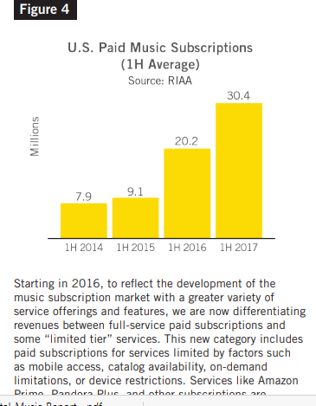
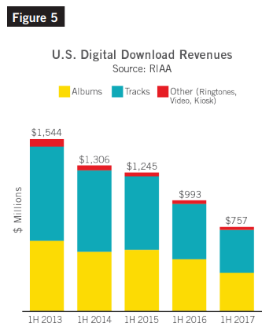
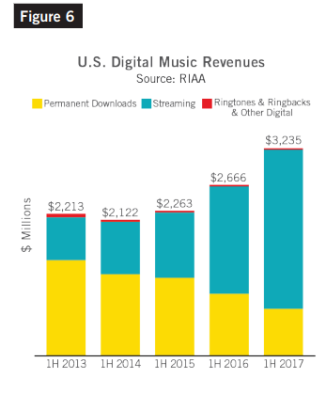
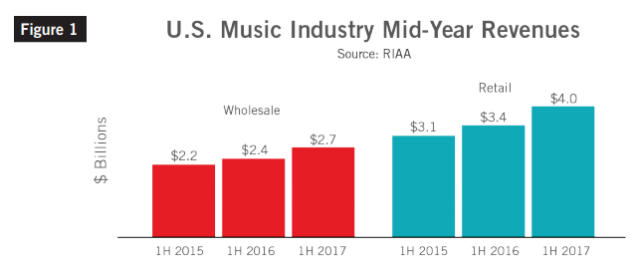
AS STREAMING REVENUES INCREASE, PAID SUBSCRIPTIONS INCREASE AND DIGITAL DOWNLOADS DECREASE WHICH MEANS THE ARTIST’S SHARE OF REVNUE DECREASES IN DIRECT PROPORTION TO STREAMING REVENUES INCREASING
https://www.riaa.com/wp-content/uploads/2017/09/RIAA-Mid-Year-2017-News-and-Notes2.pdf

Slide 14
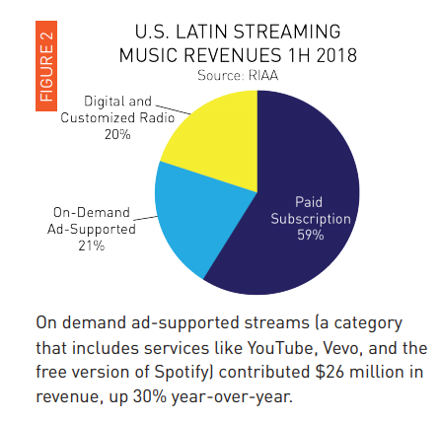
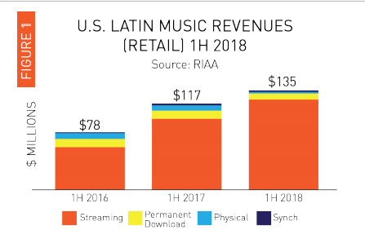
AS STREAMING REVENUES INCREASE, PAID SUBSCRIPTIONS INCREASE AND DIGITAL DOWNLOADS DECREASE WHICH MEANS THE ARTIST’S SHARE OF REVNUE DECREASES IN DIRECT PROPORTION TO STREAMING REVENUES INCREASING
https://www.riaa.com/wp-content/uploads/2018/10/RIAA_LatinMidYear_100918a.pdf

Slide 15
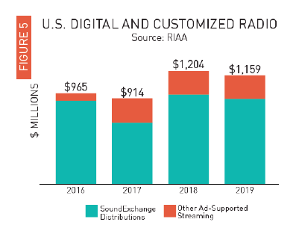
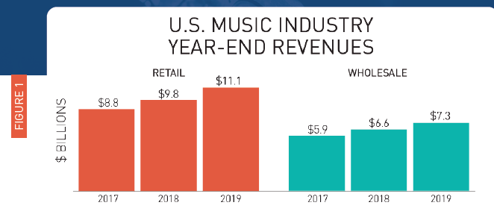
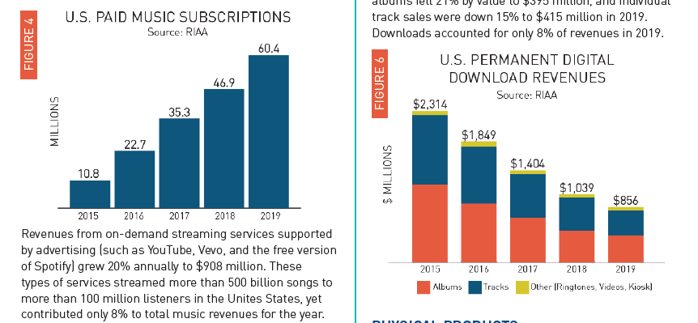
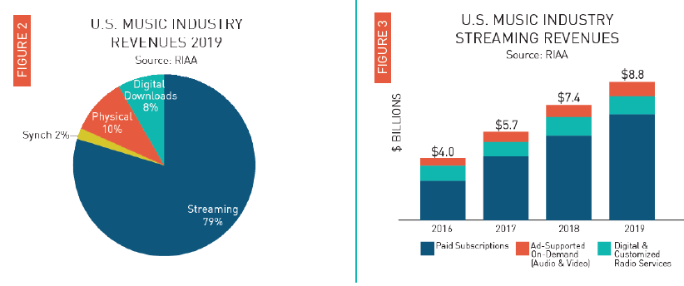
AS STREAMING REVENUES INCREASE, PAID SUBSCRIPTIONS INCREASE AND DIGITAL DOWNLOADS DECREASE WHICH MEANS THE ARTIST’S SHARE OF REVNUE DECREASES IN DIRECT PROPORTION TO STREAMING REVENUES INCREASING
https://www.riaa.com/reports/riaa-releases-2019-year-end-music-industry-revenue-report/

Slide 16
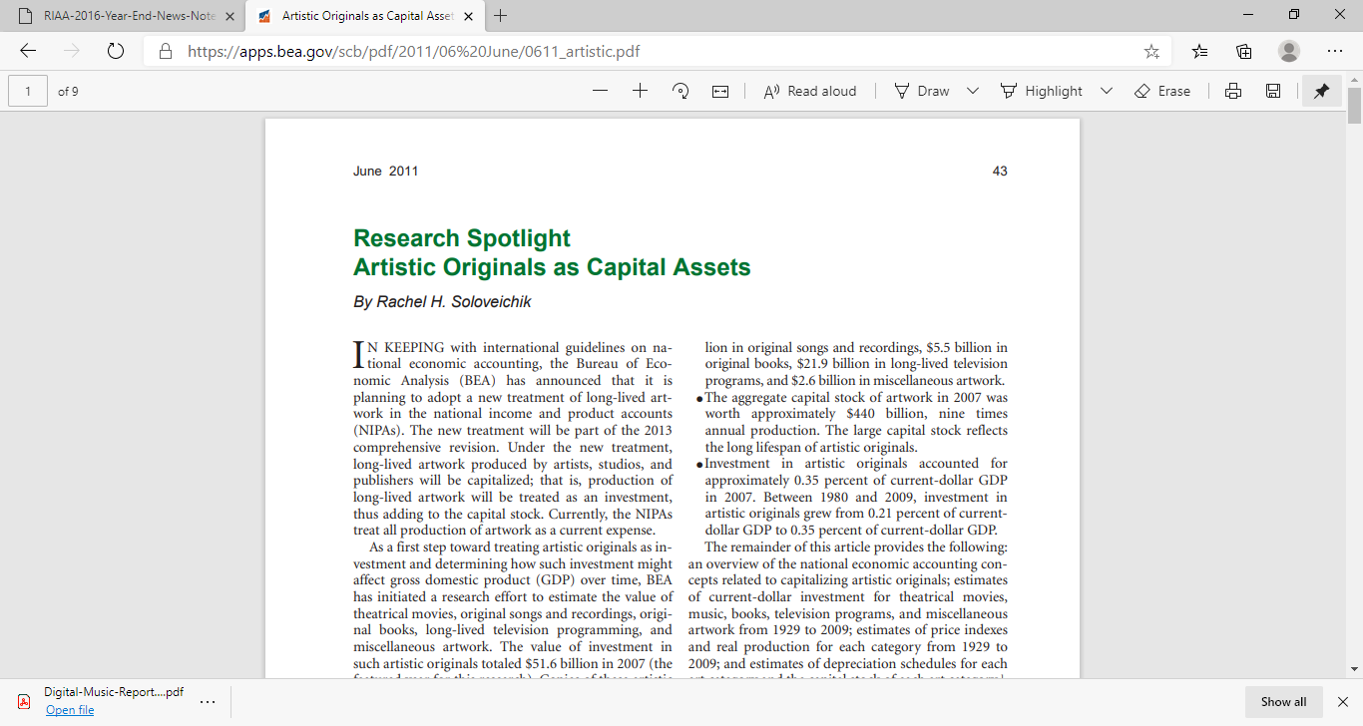
OUR PROPRIETARY PORTFOLIO STRUCTURE SHIFTS THE FOCUS FROM VENTURE CAPITAL INVESTMENT CRITERIA WHICH FOCUSES ON THE BUSINESS ITSELF, TO DIVERSIFIED PROJECT EQUITIES STRUCTURED TO BE RISK WORTHY INVESTMENTS FOR FINANCIAL INSTITUTIONS OFFERING PROJECT FINANCE THROUGH PRINCIPAL PROVIDER CREDIT ENHANCEMENT AND ASSET MONETIZATION PROCESSES. OUR PORTFOLIO STRUCTURE FOCUSES ON LEVERAGING ARTISTIC ORIGINALS AS ASSETS TO PROVIDE INVESTORS WITH DESIRED RATES OF RETURN ON INVESTMENT AND EQUITY.
https://apps.bea.gov/scb/pdf/2011/06%20June/0611_artistic.pdf

Slide 17
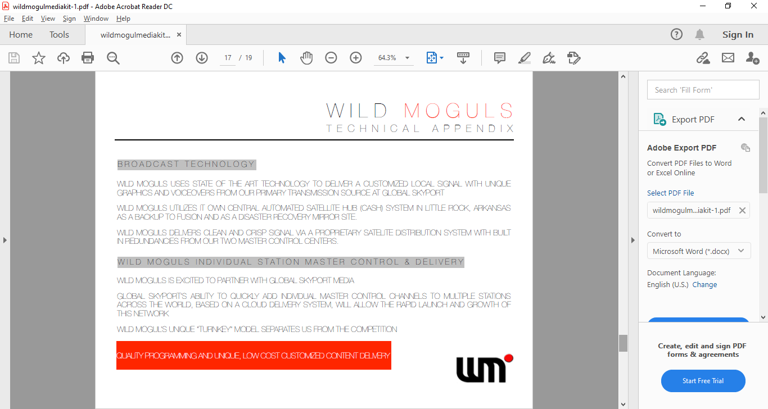
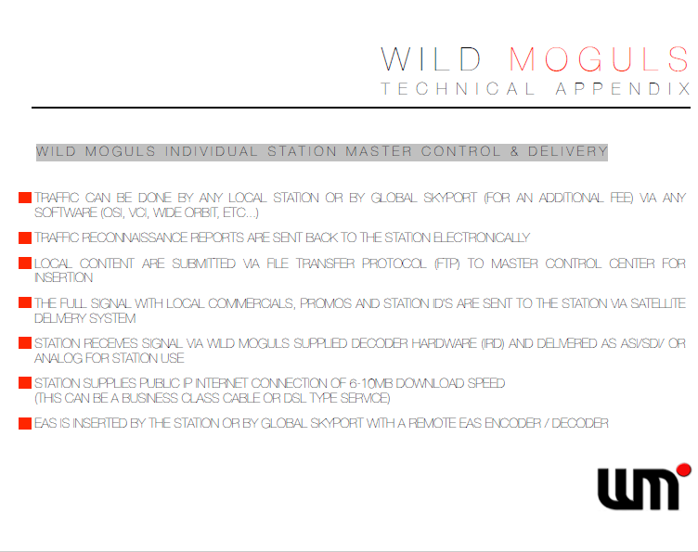
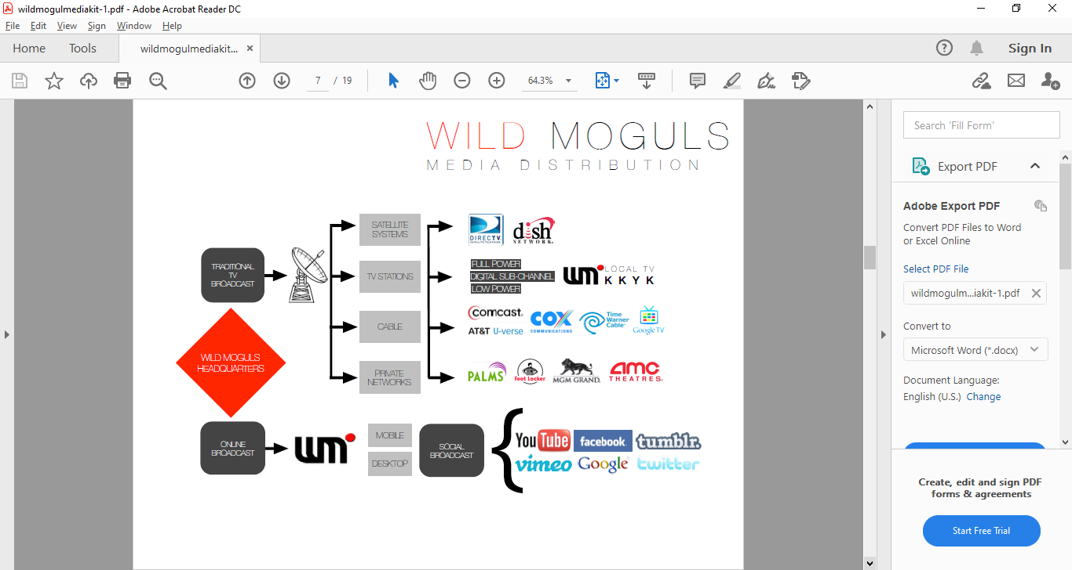
WILD MOGULS DISTRIBUTION NETWORK (SOURCE: 2015 BUSINESS DEVELOPMENT CORRESPONDENCE WITH WILD MOGULS)

Slide 18
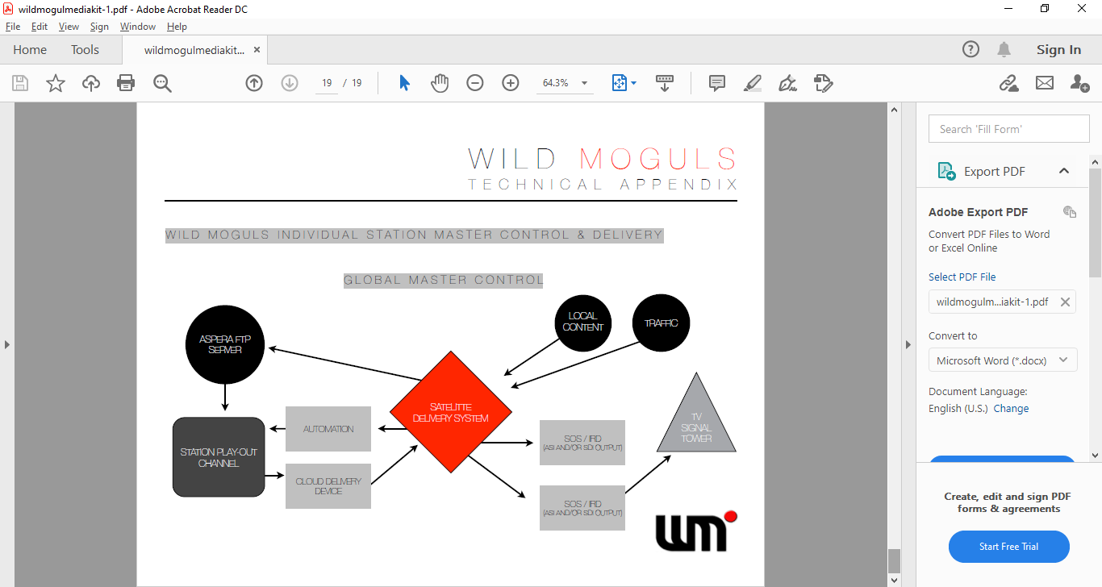
WILD MOGULS DISTRIBUTION NETWORK (SOURCE: 2015 BUSINESS DEVELOPMENT CORRESPONDENCE WITH WILD MOGULS)

Slide 20
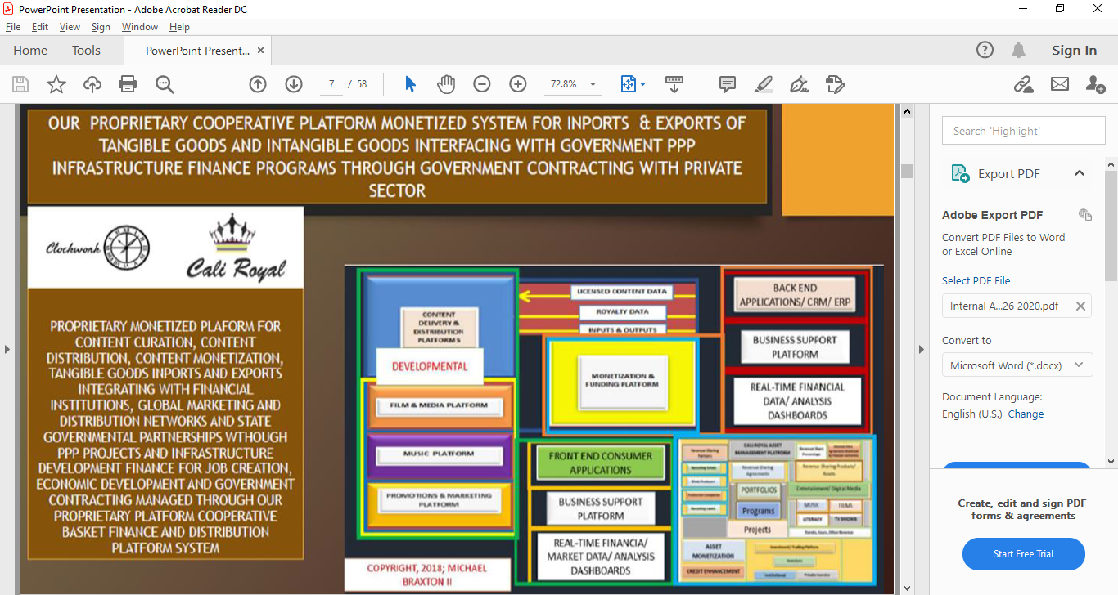
VALUE ADDED PROPOSITION THROUGH CALIROYAL PLATFORMS

Slide 21
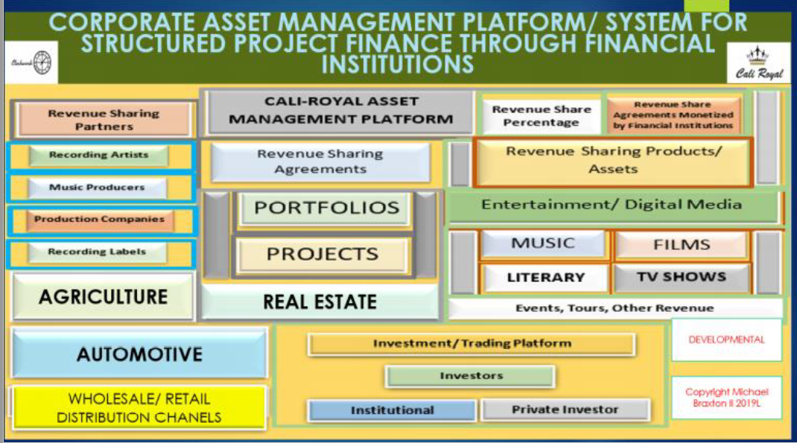
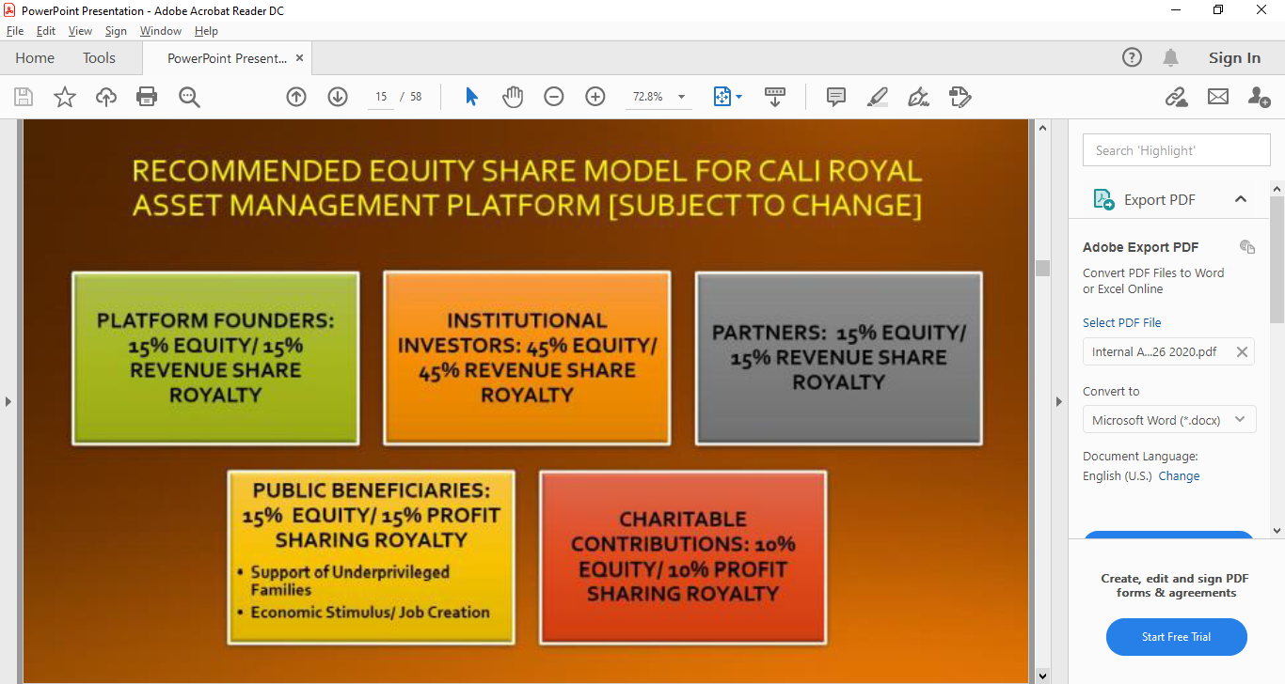
VALUE ADDED PROPOSITION THROUGH CALIROYAL PLATFORMS

Slide 22
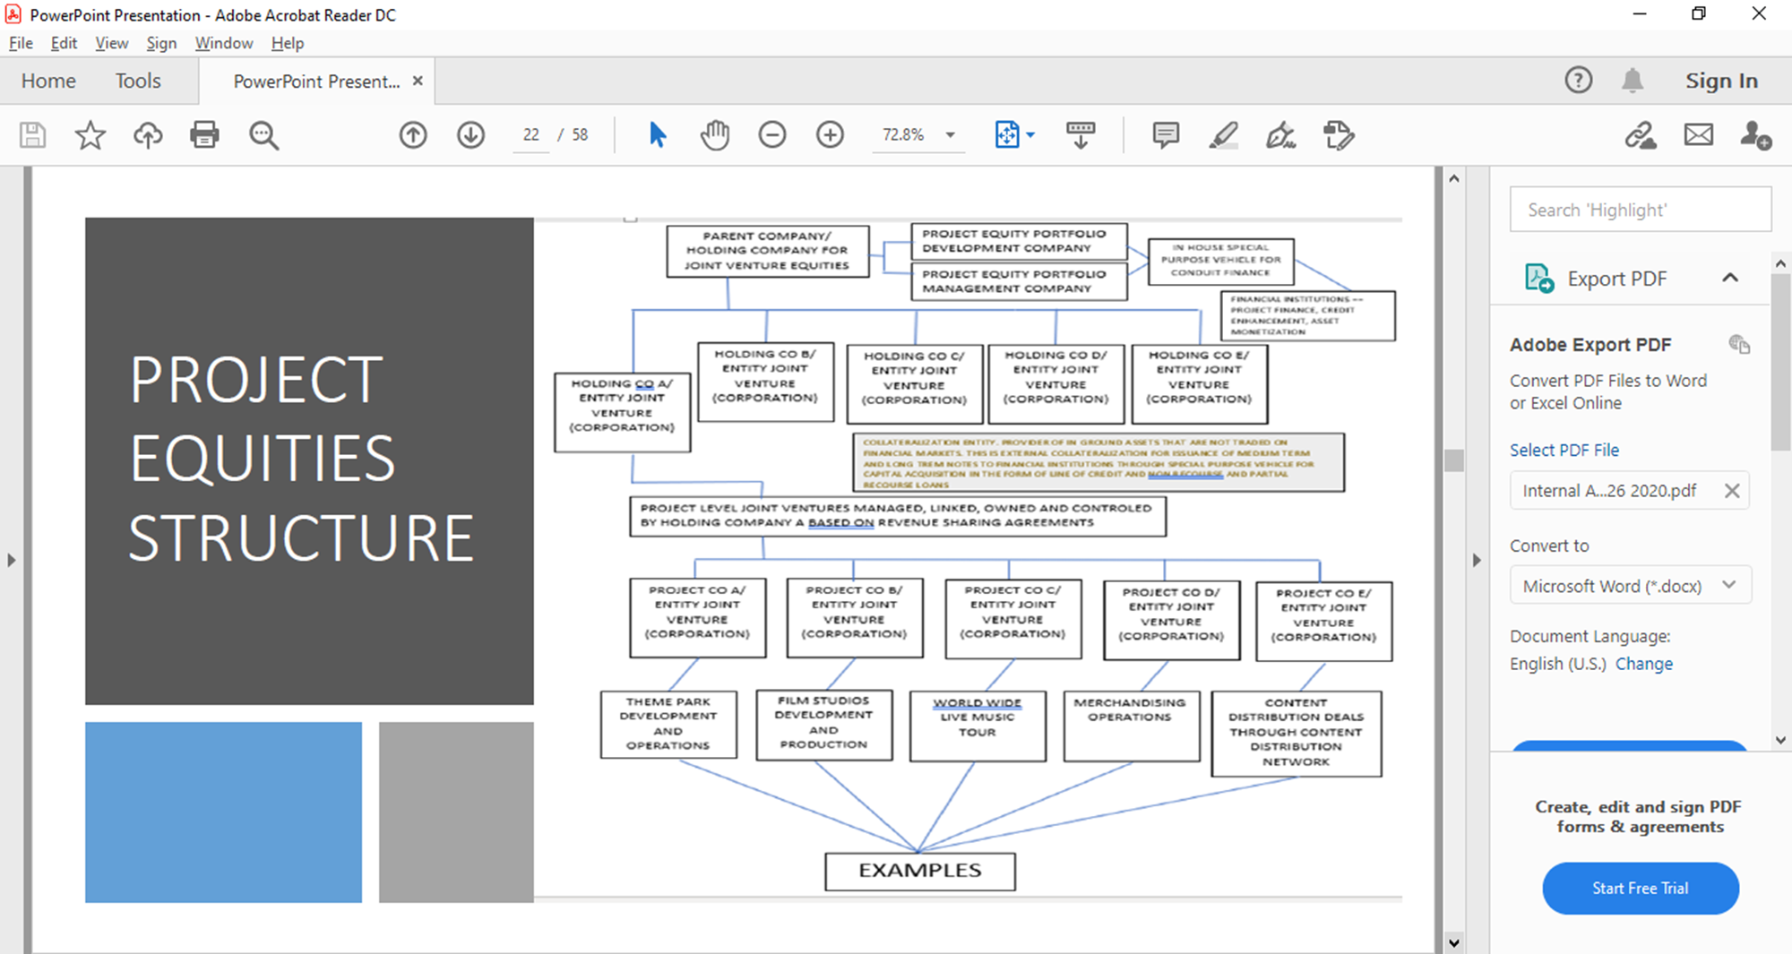

Slide 23
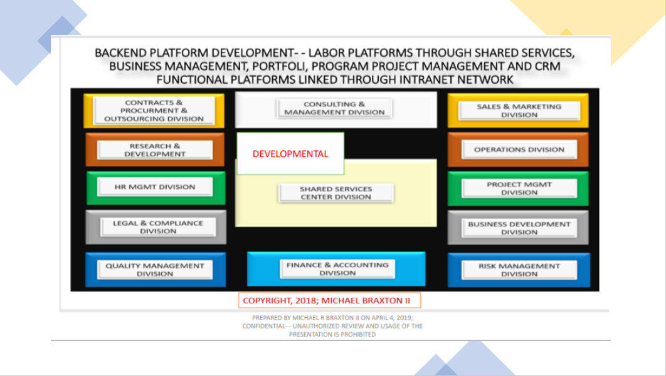

Slide 24
